Slide 1

Model PowerPoint Slides for Option B Presentations
Notes:
Districts should use a design/layout that they prefer.

Slide 2
The purpose of this Model PPT is to provide districts with slides that explain Option B using graphics.
It is our hope that districts will use these slides, as deemed appropriate, in various presentations to students, parents, staff, community groups, or employers. Some slides might be appropriate to show staff or counselors during training and other slides might be best for students, parents and community members. Some slides have Notes providing suggestions.
We also hope counselors will find some of these slides useful for one-on-one counseling sessions with students and parents.
The Charter System Foundation publishes resources, including a comprehensive Guide to Option B, for Districts in its “Option B Resource Center” at https://charter-system.org/option-b-districts/
Notes:
Districts should use a design/layout that they prefer.

Slide 3

In counseling students regarding Option B, it is important to consider where the jobs are…
Notes:
Districts should use a design/layout that they prefer.

Slide 4


Slide 5
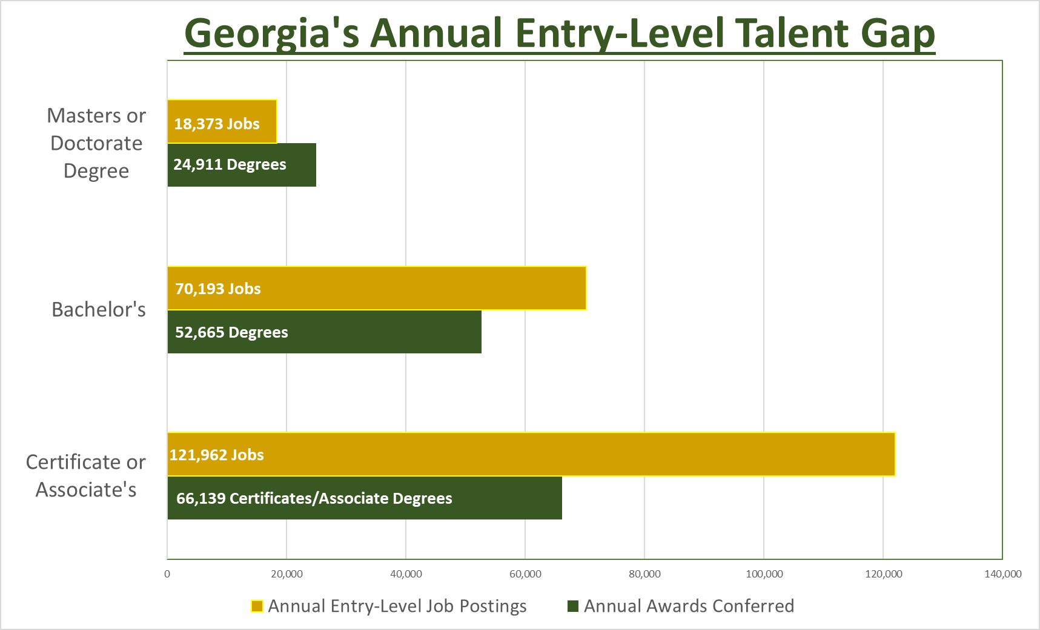






Slide 6
Districts may want to add introductory slides here to show information unique to their program or their area.
This would also be a good place for districts to include slides showing the needs of local and regional employers.
Other information might be shown here as well - for example, see next page showing the Evans County Pipeline for Option B.
Notes:
Districts should use a design/layout that they prefer.

Slide 7
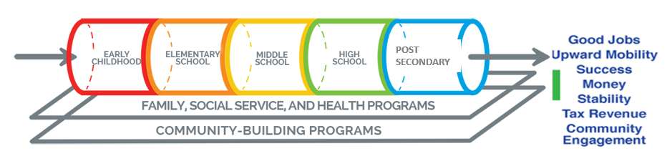
Marty Waters, Superintendent Evans County Schools

Slide 8

Pathways to a high-demand career or college…

Slide 10


Slide 11
The next slide compares Option A vs. Option B pathways during and after high school. The gray boxes show funding.
It would take a few minutes to explain this graphic, but we think it will help students and parents see possibilities.

Slide 12
Notes:
Option A – College-Prep HS pathway is best if the student who wants to pursue a 4-year baccalaureate degree after high school graduation. Other students should compare the advantages and disadvantages of the Non-College-Prep pathway (with or without CTAE pathway) vs. the Option B Pathway.
For the Option B graduate who earned two TCCs or a TC Diploma, HOPE Grant will pay for 30 hours for an Associate Degree at the TC. HOPE Grant will not pay for an Associate Degree for an Option A graduate (but the student could qualify for HOPE Scholarship).
If a high school student is enrolled in an Associate Degree program, DE will pay for the first 30 hours but above that level the student must self-pay while in high school. Instead of enrolling a high student in an associate degree program, an option is to enroll the student in a TC Diploma program and have the student take degree-level academic courses that are transferable. HOPE Grant will then pay for the Diploma courses. Once the student completes the Diploma and starts in the Associate Degree program while in high school, the student will have to begin self-pay.

Slide 13

Advantages of Option B Pathway
For a student who wants to work in a high-demand field upon graduation or cannot afford college, Option B allows the student to graduate with:
A work-ready college credential
paid (all or mostly) by Dual Enrollment and HOPE Grant (Associate Degree during HS would require some self-pay), and
relevant work experience with local employer
AND THEN…
after high school, HOPE Grant will pay for 30 hours for Associate Degree at technical college (not available to Option A student).

Slide 14

Funding Sources….

Slide 15
Note that student must meet program other eligibility requirements for each funding program
Notes:
Counselors could use this chart as reference. They could also show it to students and parents.

Slide 16
Notes:
Counselor may want to use this chart for reference and/or give it to students and parents.

Slide 17
Other Eligibility Requirements (GSFC website)…
The DE eligibility requirements focus on whether the student is enrolled in the HS. Residency is not an issue. The HOPE Grant eligibility requirements focus on citizenship/legal residency. This could create a problem for the student who is not a citizen/legal resident. That student could sign up for Option B with DE funding, but then not qualify for HG Funding after DE CAP is reached.
Dual Enrollment Eligibility Requirements
Student Eligibility
A student must be enrolled in and physically attending a participating eligible public or private high school in Georgia or an eligible participating home study program in Georgia.
A student must be approved, by the participating high school or home study program at which he or she is enrolled, to participate in dual enrollment.
Prior to participating in Dual Enrollment, as part of the application process, the student and student’s parent/guardian must complete the Student Participation Agreement (SPA).
A student must have completed the admission process and been accepted and approved by the participating postsecondary institution.
All postsecondary coursework must be completed prior to high school graduation or home study completion in order to receive Dual Enrollment credit and funding.
HOPE Grant Eligibility Requirements
All HOPE programs require students to meet basic requirements. An eligible student must:
Meet HOPE's U.S. citizenship or eligible non-citizen requirements;
Be a legal resident of Georgia;
Meet enrollment requirements;
Be in compliance with Selective Service registration requirements;
Meet academic achievement standards;
Be in good standing on all student loans or other financial aid programs;
Be in compliance with the Georgia Drug-Free Postsecondary Education Act of 1990;
Not have exceeded the maximum award limits for any HOPE program;
Regardless of the number of HOPE Grant Paid-Hours or Combined-Paid Hours a student has accumulated, such student is ineligible for HOPE Grant payment if he or she has attained a Baccalaureate Degree, at any time, from any postsecondary institution, including the equivalent of a Baccalaureate Degree from a foreign institution as indicated by the foreign academic transcript and/or foreign academic transcript translation

Slide 18

Which Option B Pathway Fits You Best?

Slide 19


Slide 20

Funding for Two-TCC Pathway
Notes:
Perhaps these detailed funding slides should be used by counselors only as a reference. Counselors might want to give these slides to students and parents when counseling one on one. These slides should be read in conjunction with the HOPE Grant Funding Chart earlier in the presentation.

Slide 21

Notes:
Perhaps these detailed funding slides should be used by counselors only as a reference. Counselors might want to use these slides as handouts to students and parents when counseling one on one. These slides should be read in conjunction with the HOPE Grant funding chart earlier in the presentation.

Slide 22

Funding for Associate Degree Pathway
Notes:
Perhaps these detailed funding slides should be used by counselors only as a reference. Counselors might want to give these slides to students and parents when counseling one on one. These slides should be read in conjunction with the HOPE Grant Funding Chart earlier in the presentation.

Slide 23
Here the district can present information as to which TCC pathways it offers in partnership with its technical college.
The current list of TCC pathways approved by TCSG is included in the Guide to Option B that can be downloaded from the Foundation’s Option B Resource Center at https://charter-system.org/option-b-districts/
If a district wishes to add a new TCC pathway, we encourage you to work with your technical college to ask that TCSG add the new pathway to the approved list. We also ask that you let us know of any plans you have to add a new TCC pathway.

Slide 24
Evans County and Ogeechee Tech currently offer these TCCs…
TCCs Offered:
Welding (Diploma also available)
  Basic Shielded Arc Welder
  Advanced Shielded Arc Welder
  Gas Metal Arc Welder
  Gas Tungsten Arc Welder
Drafting Technology (Diploma or Associate
Degree available)
  Drafter’s Assistant
  CAD Operator Mechanical
Remember that an Option B student may graduate with:
ANY Diploma from a technical college
or…
ANY Associate Degree from a USG institution or technical college

Slide 25
By way of further example, this slide and the next show the list of TCC pathways available in Coffee County, which has a well-developed Option B program.

Slide 27
We think students and parents need to be able to visualize the general relationship between CTAE, TCCs, Diploma and Associate Degree.
We suggest the following slides as one way to show that relationship. Perhaps the district should generate one of these slides for each of the TCC pathways it offers.

Slide 28

Welding Pathways

Slide 29

Drafting Technology Pathways

Slide 30
In the following slide, we show how a district might add specific employer information at the bottom to show what opportunities a student would have upon graduation for the various credential levels.

Slide 31
Drafting Technology Pathways
Notes:
Here is hypothetical example of how the slide might look if specific employer information is added to the bottom. We think students and parents will want to know what opportunities are available for each credential level.

Slide 32


What your high school schedule will look like…

Slide 33
In this section, the district can show what the high school schedule could look like.
We provide several examples from Option B districts.
Notes:
Districts should use a design/layout that they prefer.

Slide 34
Notes:
Here the district should show the high school schedule for the student. It might be best to show a “base” HS schedule like the one above to show how the student will complete the 9 high school courses by the middle of 10th grade (or later?), and that the postsecondary courses and work experience will be completed the second half of 10th grade and 11th and 12th grades.

Slide 35
Notes:
Here the Central Educational Center (Coweta) shows how it would build a schedule for 4 Welding TCC’s on top of their base HS schedule.

Slide 36

What does the Graduation Plan look like for Drafting Technology 2 TCC Pathway?
This is what a Graduation Plan might look like for a student that wants to enter the workforce as soon as possible.
9th Grade
10th Grade
11th Grade
12th Grade
Fall Semester
Health and PE
9th Grade Literature
Algebra I
Spanish I
Spring Semester
US History
Environmental Science or Physical Science
Spanish II
Occupational Safety
Fall Semester
American Literature
AMDM (math)
DFTG 1101
EMPL 1000
Spring Semester
World History
Biology
DFTG 1103
DFTG 1105
DFTG 1107
DFTG 1109
WBL Internship
Ready to enter the workforce with a high school diploma.
Working in the field of Drafting!
Notes:
Here Gordan County shows the 2 TCC schedule for Drafting Technology.

Slide 37
What does the Graduation Plan look like for Drafting Technology Technical College Diploma?
This is what a Graduation Plan might look like for a student that wants to graduate high school with a Technical Diploma.
*DE courses may be taken during the summer to adjust scheduling.
*Student will need to take additional academic courses if planning on attending a 4-year college.
9th Grade
10th Grade
11th Grade
12th Grade
Fall Semester
Health and PE
9th Grade Literature
Algebra I
Spanish I
Spring Semester
US History
Environmental Science or physical Science
Spanish II
Occupational Safety
Fall Semester
American Literature
Biology
DE CAD Fundamentals
DE EMPL 1000
Spring Semester
World History
Geometry
DE Multiview/Basic Dimensioning
DE 3D Mechanical Modeling
Fall Semester
DE Foundations of Math
DE Fundamentals of Eng.
DE Student Success
DE Visualization and Graphics (Occ. elective)
Spring Semester
DE Advanced Dimensioning/Sectional Views
Practical Math Drafting
DE Engineering Graphics (Occ. Elective)
DE Fasteners
Fall Semester
DE Assembly Drawings
DE Auxiliary Views/Surface Development
DE Exit Practicum (Occ. Elective)
WBL internship
Notes:
Here Gordan County shows the Diploma schedule for Drafting Technology.

Slide 38
What does the Graduation Plan look like for Drafting Technology Associate Degree?
This is what a Graduation Plan might look like for a student that wants to graduate high school with an Associates Degree.
*DE courses may be taken during the summer to adjust scheduling.
* Student may be responsible for cost of courses outside of Grant Funding Approval.
9th Grade
10th Grade
11th Grade
12th Grade
Fall Semester
Health and PE
9th Grade Literature
Algebra I
Spanish I
Spring Semester
US History
Environmental Science or physical Science
Spanish II
Occupational Safety
Fall Semester
American Literature
Biology
DE CAD Fundamentals 4
EMPL 1000 2
Spring Semester
World History
Geometry
DE Multiview/Basic Dimensioning 4
DE 3D Mechanical Modeling 4
Fall Semester
DE College Algebra 3
DE Comp. and Rhetoric 3
DE Economics 3
Physics if going to 4yr college
Spring Semester
DE Precalculus 3
DE English Literature 3
DE Advanced Dimensioning/Sectional Views 4
DE Engineering Graphics (Occ. Elective) 4
Fall Semester
DE Fasteners 4
DE Assembly Drawings 4
DE Auxiliary Views/Surface Development 4
DE Visualizaion and Graphics (Occ. Elective) 3
Spring Semester
DE Adv. 3D Mechanical 4
DE Architectural 3D Modeling (Occ. Elective) 4
DE Exit Practicum (Occ. Elective) 3
WBL or Chemistry (if going to 4yr. College)
Notes:
Here Gordon County shows the Associate Degree schedule for Drafting Technology.

